Slide 1
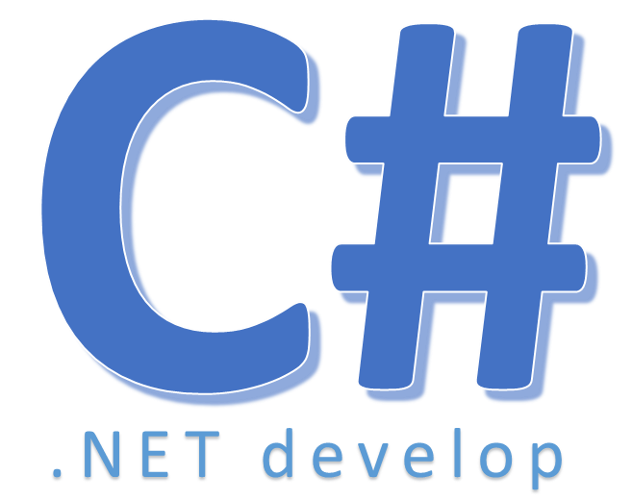

Foreach

Slide 2

Foreach
Performs the specified action on each element of the specified array or list. (It doesn’t actually use the System.Predicate delegate. Instead, it uses the similar System.Action delegate.
Notes:
- duyệt qua từng phần tử trong collection (list, dictional..)

Slide 3


Hey! Coding is easy!
END

